Slide 1

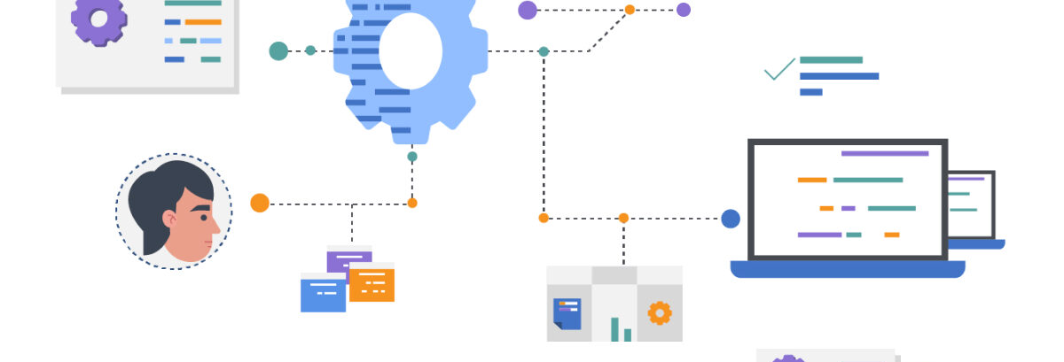
The Technology Value Stream
September 14th,2025
Kimberly Orozco

Slide 2
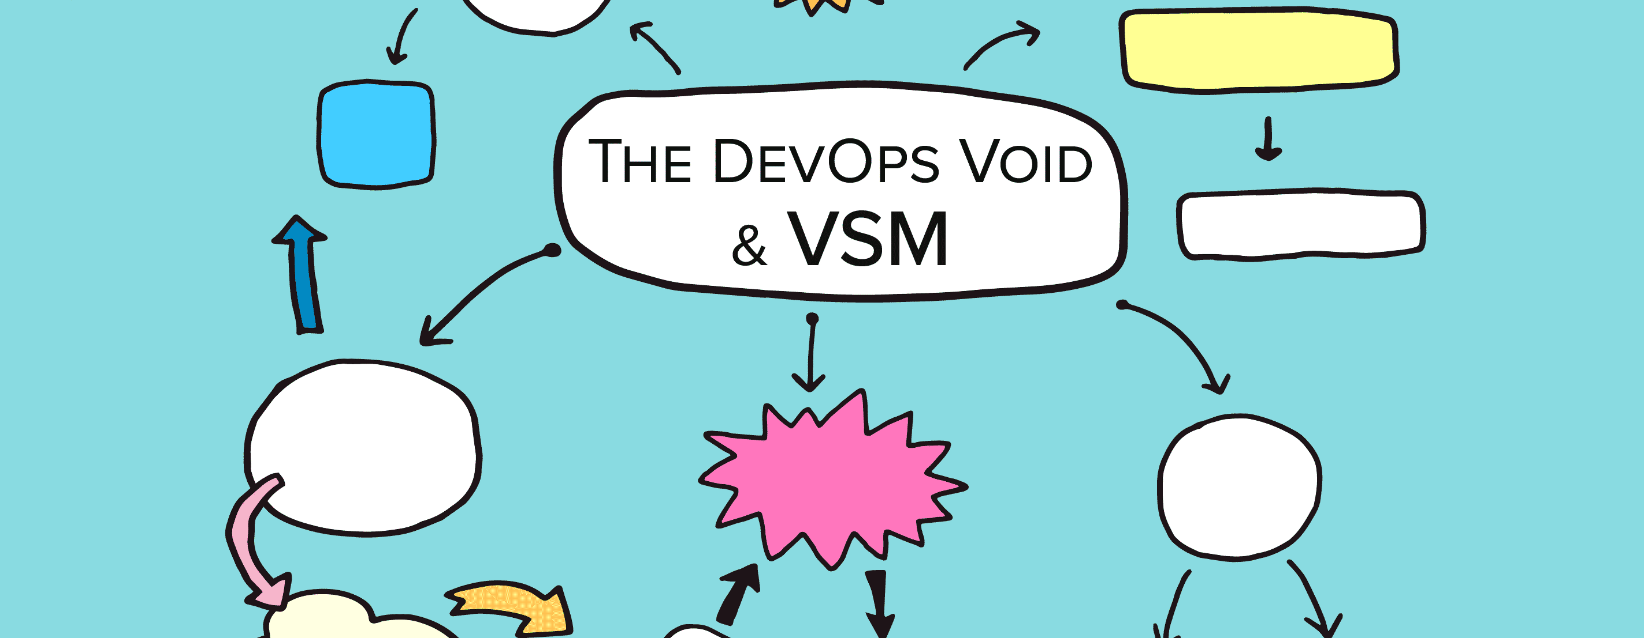
What is a Technology Value Stream?
A technology value stream shows how work moves from when someone asks for it to when it’s done. It helps teams see how fast things get done and where they can improve.

Slide 3
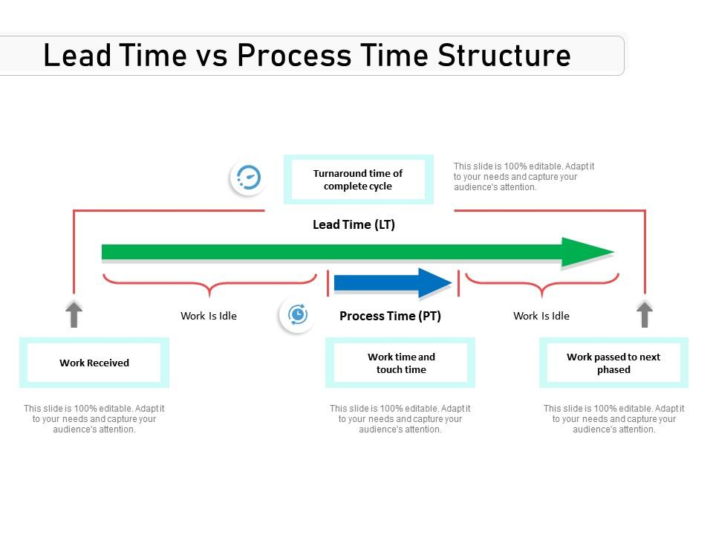
Lead Time vs. Processing Time
Lead time is how long a request takes to get finished from start to end. Processing time is only the time actually spent working on it.

Slide 4
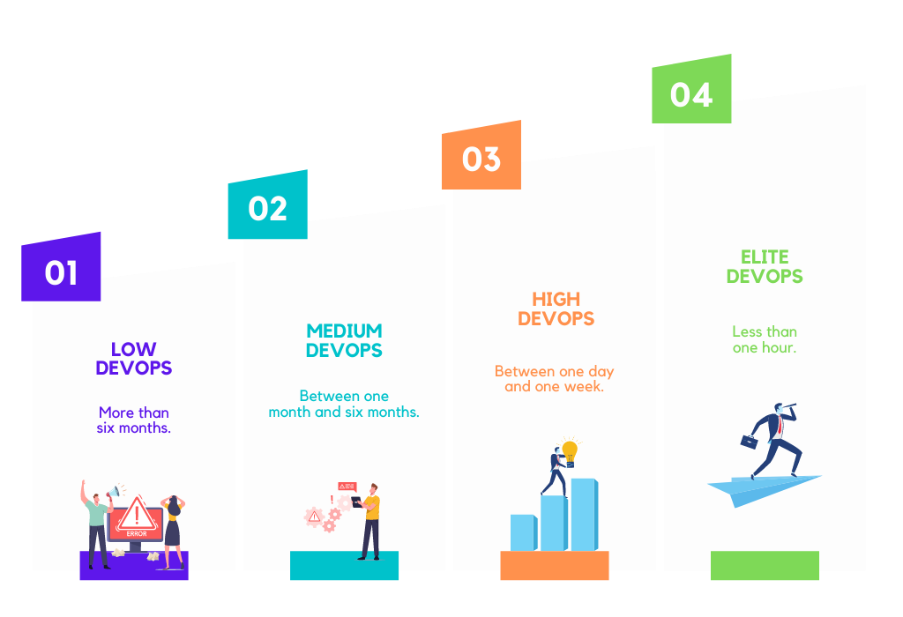
The Common Scenario: Deployment Lead Times Requiring Months
Sometimes, big companies take months to deploy code. Problems with this include:
Not enough test environments
Manual testing
Lots of approvals
This causes stress, and errors.

Slide 5
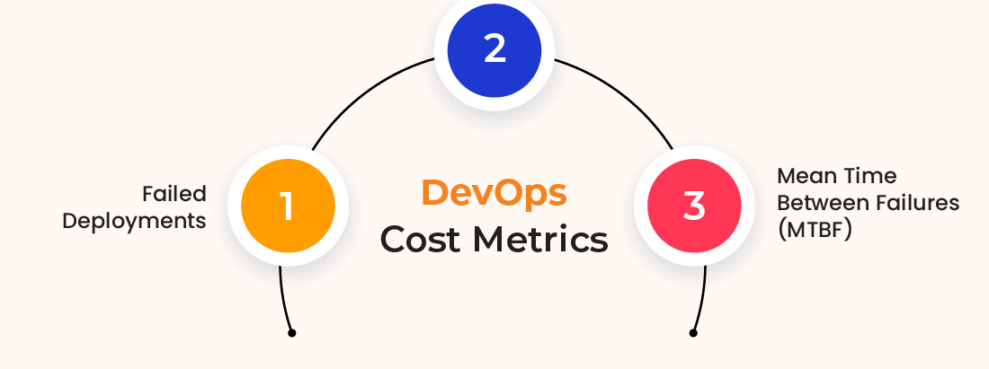
Example: 3 Months Deployment Time
When deployments take months:
Code may break
Fixing problems take days or weeks
Customers wait too long

Slide 6
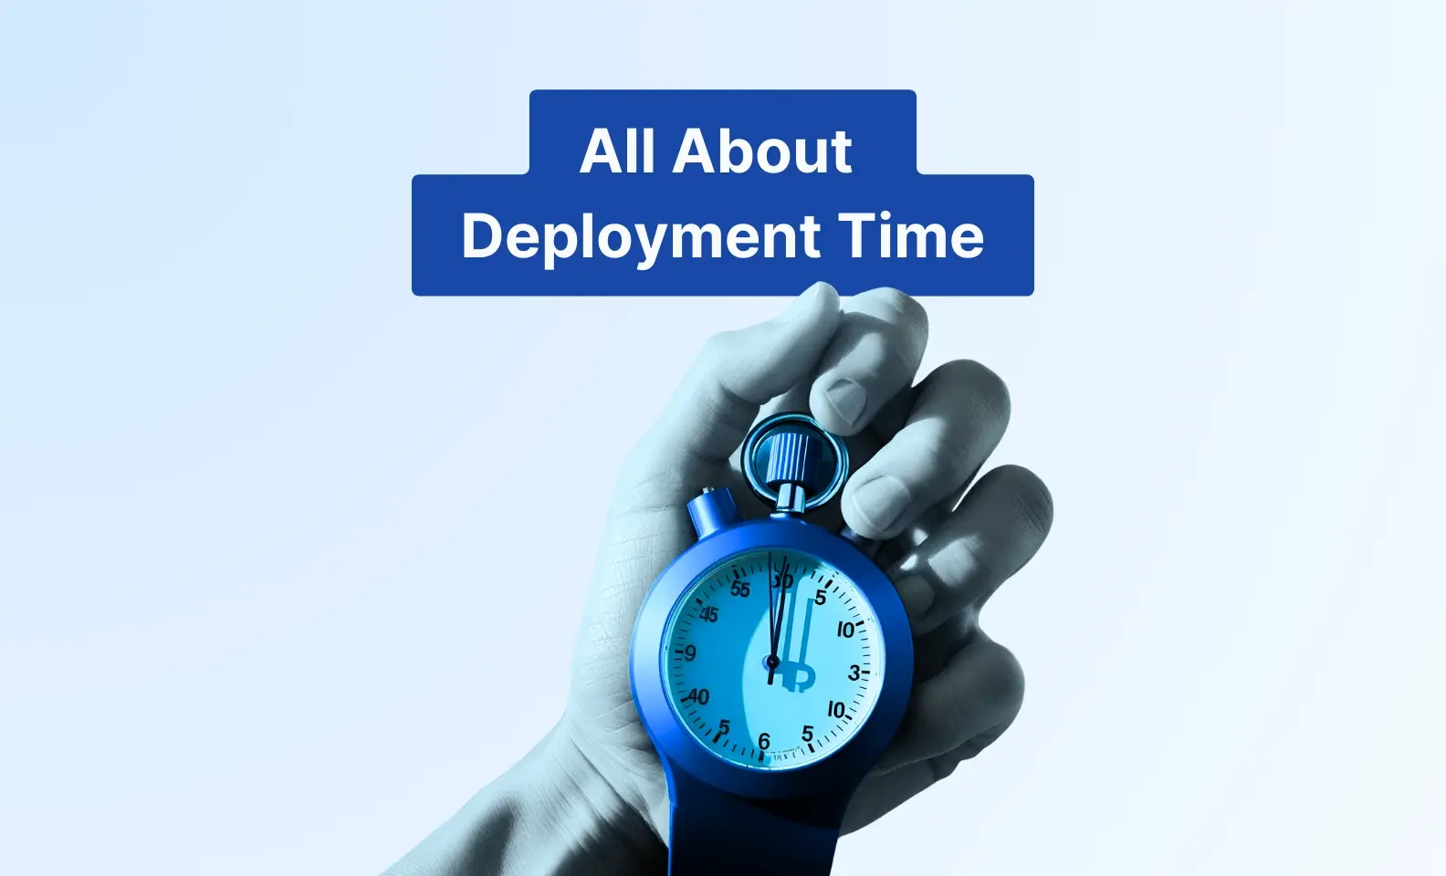
DevOps Ideal: Deployment Lead Times of Minutes
Developers get quick feedback here. They make small changes all the time and test them automatically. Our book explains that this is easiest when we have architecture that is modular.
Why this is better:
Faster deployments
Less risk of things breaking
Higher quality

Slide 7
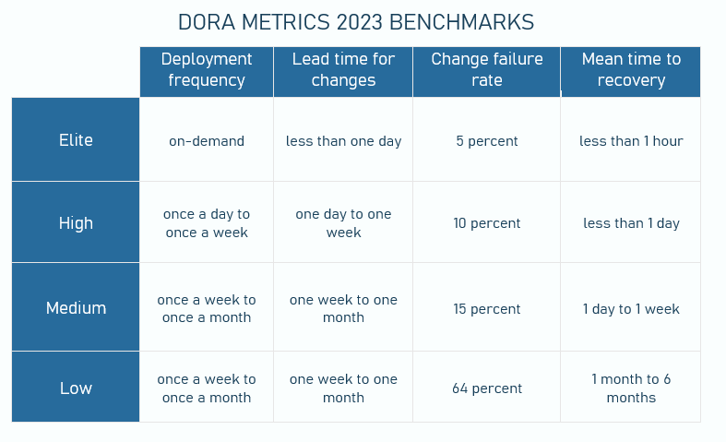
Metrics for Short Lead Times
Teams track how well work is moving!
Other flow metrics:
Flow Velocity= How many items are done.
Flow Efficiency= How much time is actually spent working.
Flow Time= Time it takes to deliver value.
Flow Load= How many items are in progress.
Flow Distribution= Types of work and their proportions.

Slide 8
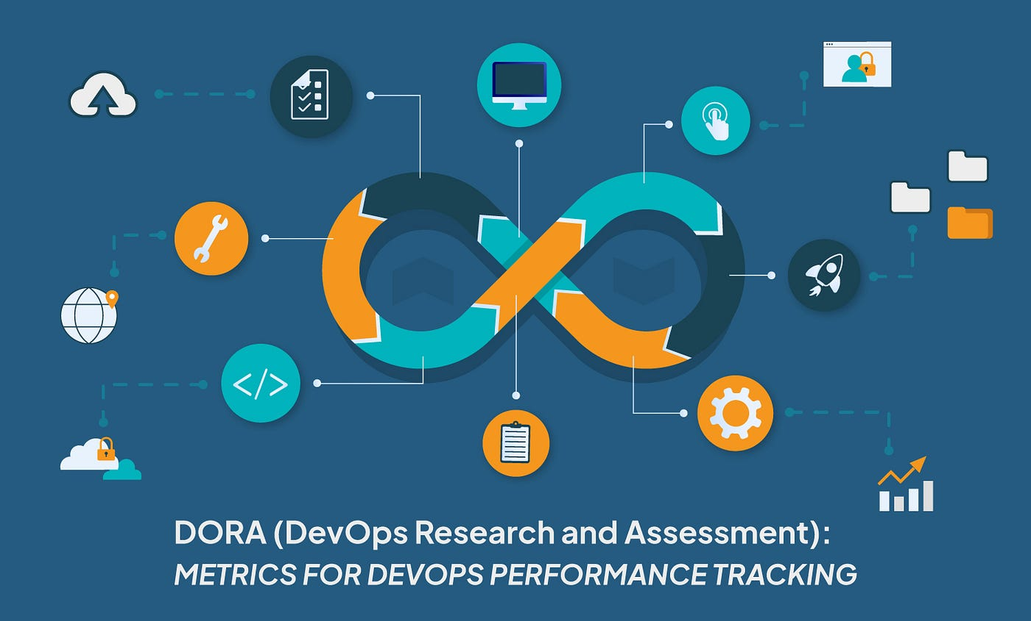
Conclusion
Lead time is how long customers wait, and processing time is the actual work time. Long lead times can cause mistakes, and delays. DevOps helps fix this by using automation, and small frequent changes. Short lead times mean better quality, and smoother deployments.

Slide 9
Resources
Atlassian. (n.d.). 4 key devops metrics to know. https://www.atlassian.com/devops/frameworks/devops-metrics
Lead time and how to measure it in devops: Devops metrics. Software.com. (n.d.). https://www.software.com/devops-guides/lead-time
Patrick Debois, N. F. (2021). DevOps Handbook, 2nd edition. IT Revolution Press.
Walsh, A. (2025, May 12). The Ultimate Guide to Optimizing Deployment Time. https://axify.io/blog/deployment-time

